Slide 1



How model standardization enables new tools and applications in neuroscientific research
Insights from the HBP
Yann Zerlaut
Neuroinformatics team / group of A. Davison
Centre National de la Recherche Scientifique, France
Open Source Brain Meeting 2019, Alghero

Slide 2
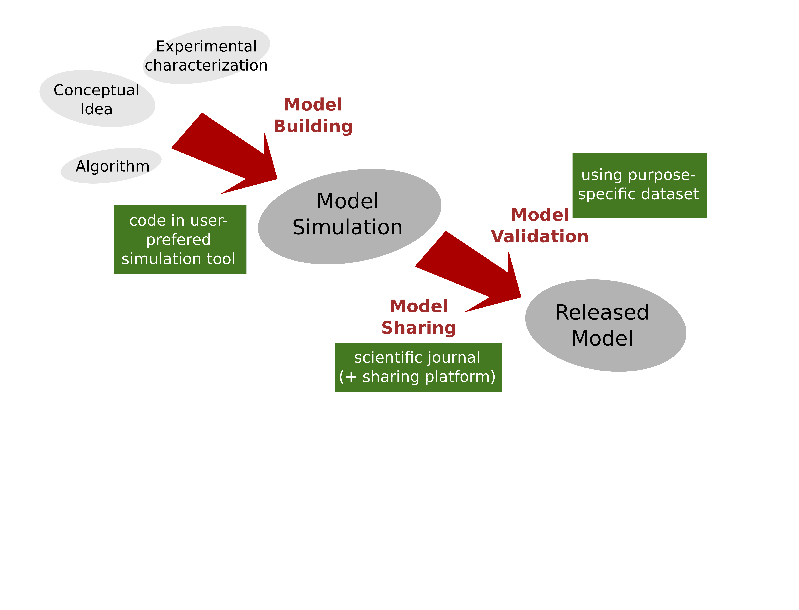
Motivation
A typical model production pipeline in neuroscientific research

Slide 3
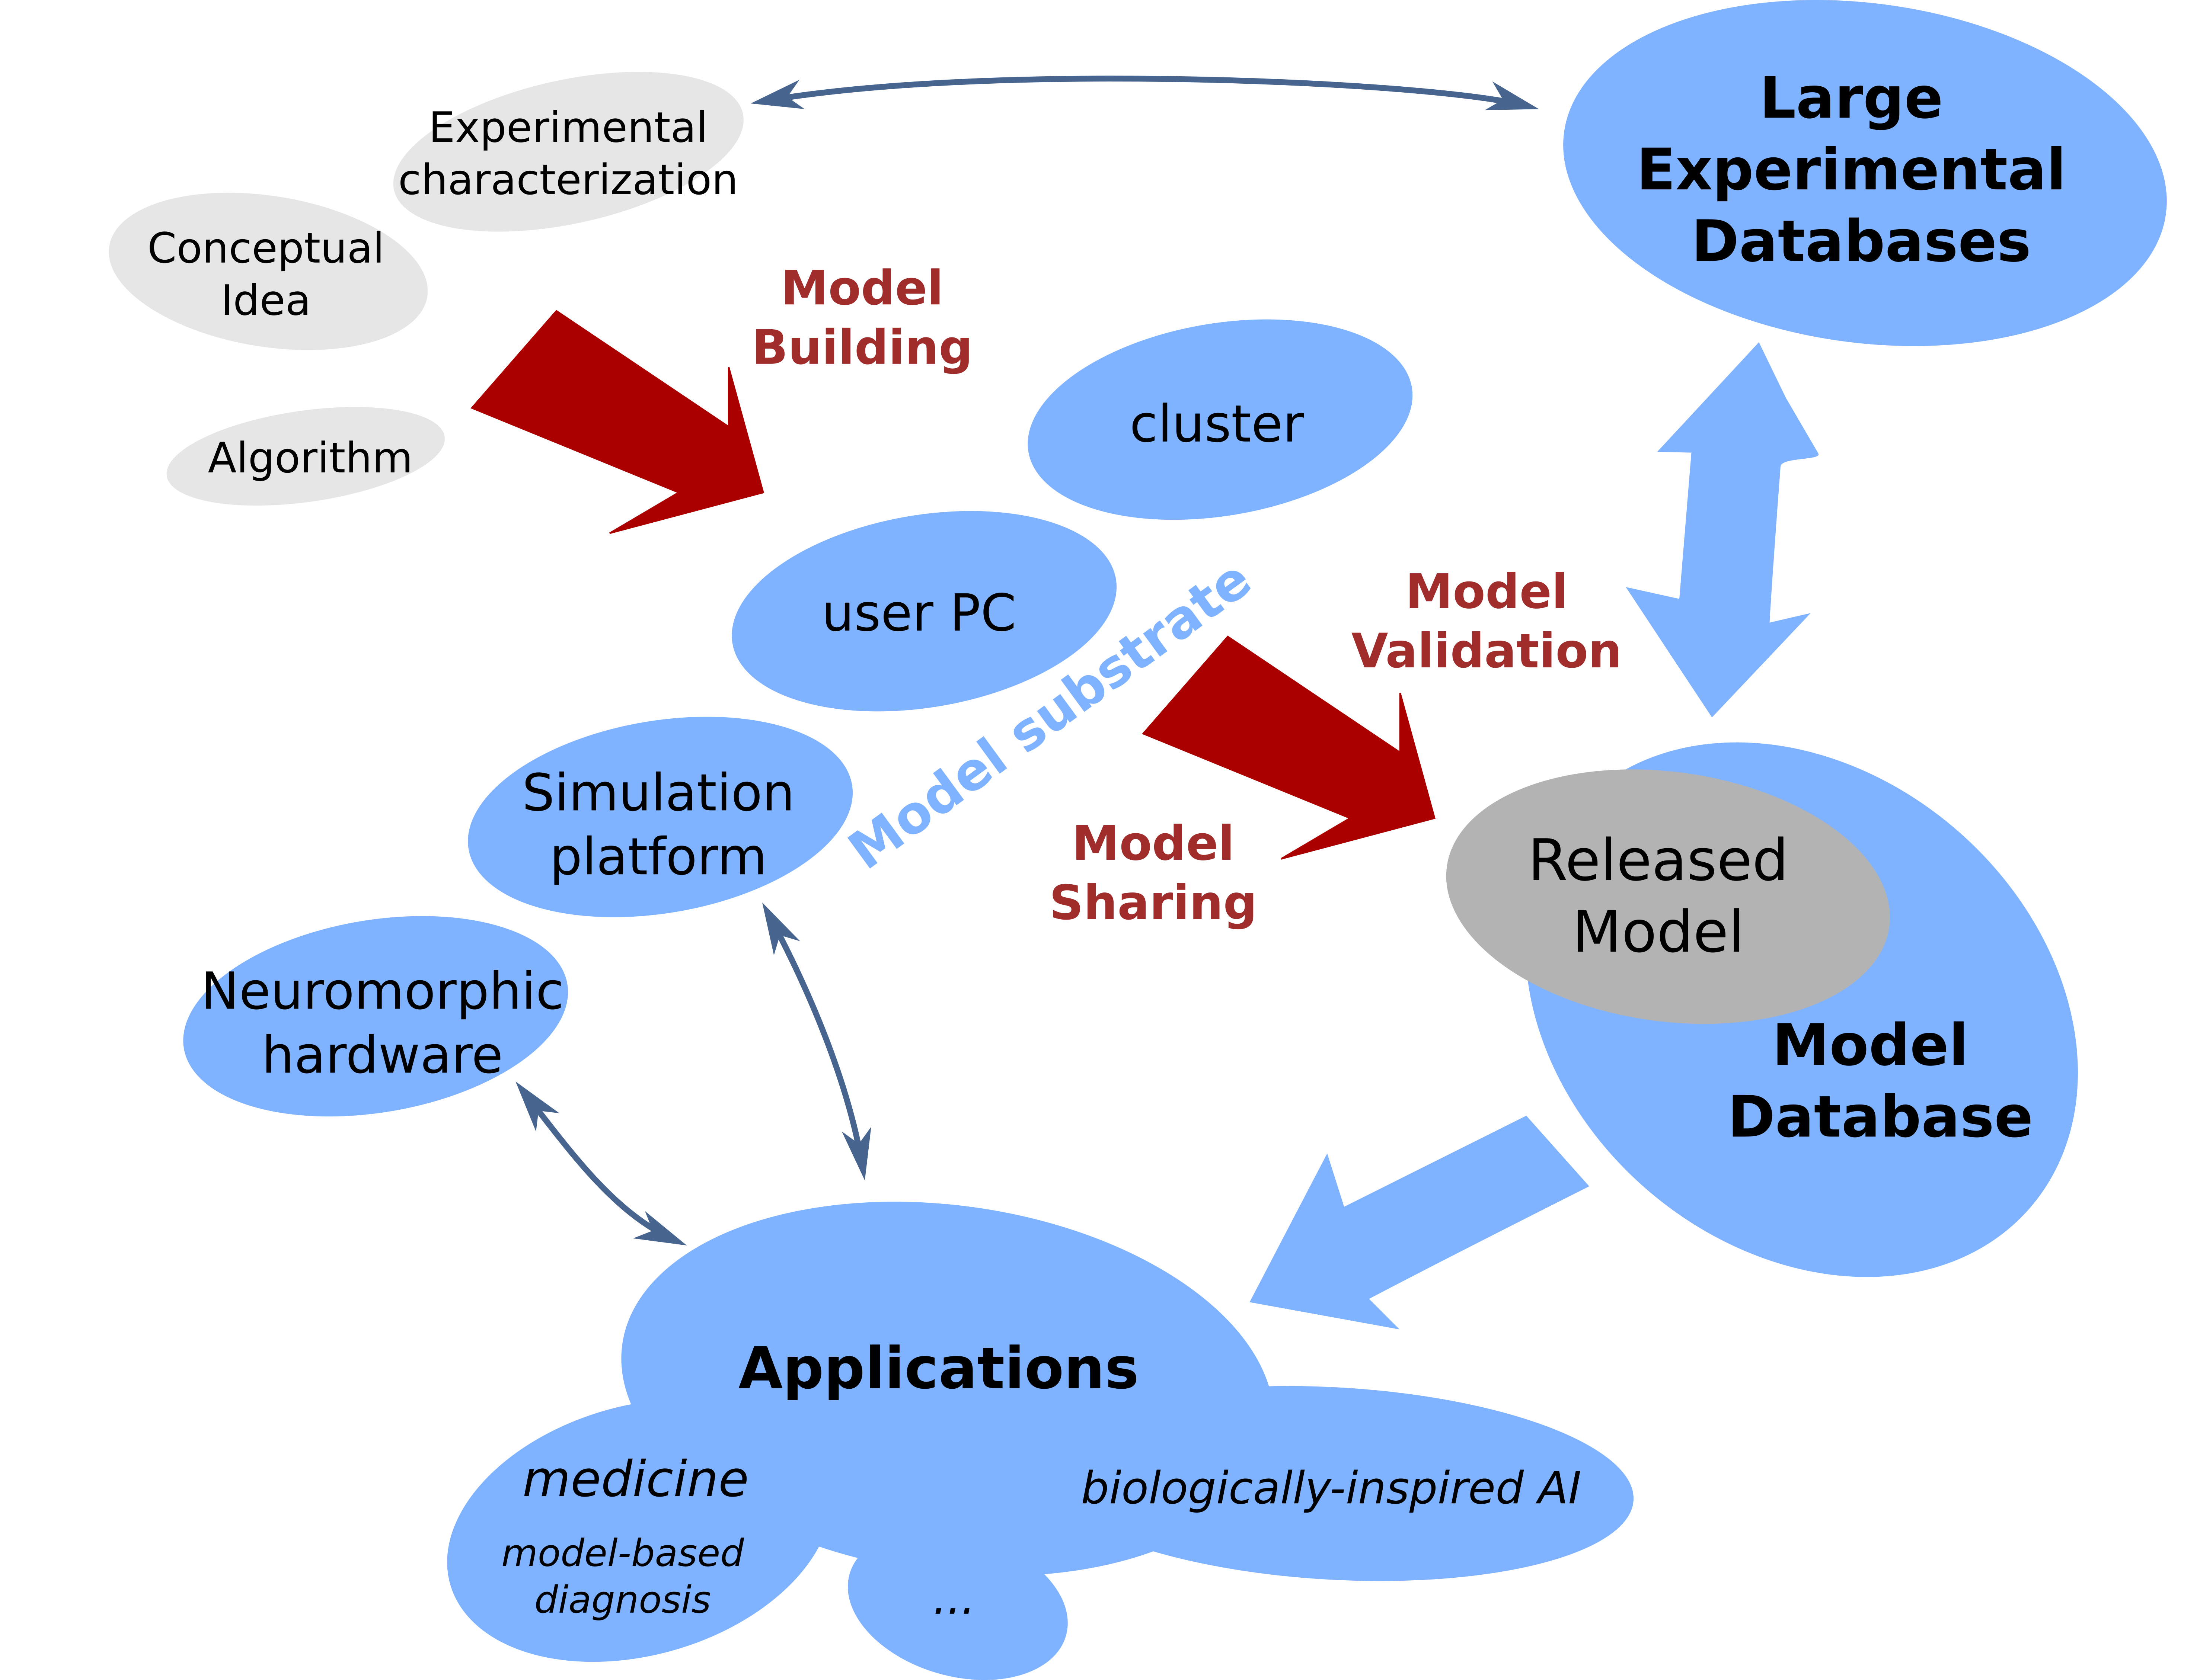
Motivation
Model production pipeline within the infrastructure and research goals of the Human Brain Project

Slide 4
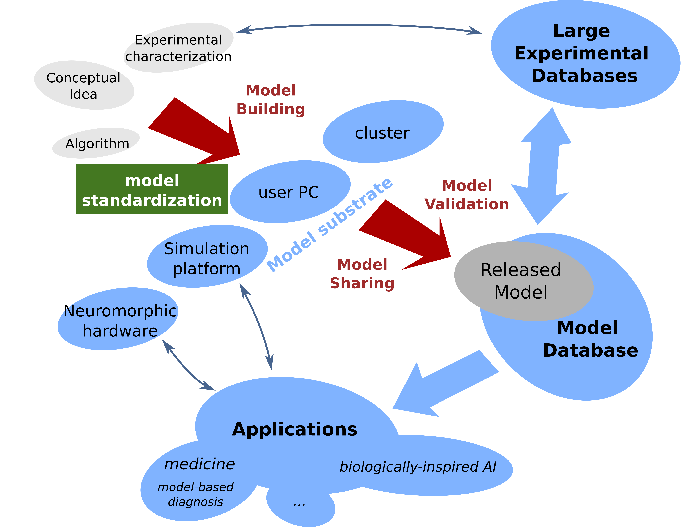
Motivation
decisive to insure the feasibility and robustness of the entire process !
Model production pipeline within the infrastructure and research goals of the Human Brain Project

Slide 5
Overview
I) Model standardization:
model building
PyNN
Sonata (pyNN.Sonata)
SciUnit
model release/sharing
Model Catalog
Knowledge Graph
Live Papers
II) New tools and applications:
Neuromorphic hardware
Neurorobotics
Brain Simulation Platform
Model Validation framework

Slide 6

A unified interface for neuronal network simulators
Simulator diversity: problems and opportunities
Cons
Considerable difficulty in translating models from one simulator to another...
...or even in understanding someone else’s code.
This:
impedes communication between investigators,
makes it harder to reproduce other people’s work,
makes it harder to build on other people’s work.
Pros
Each simulator has a different balance between efficiency, flexibility, scalability and user-friendliness → can choose the most appropriate for a given problem.
Any given simulator is likely to have bugs and hidden assumptions, which will be revealed by cross-checking results between different simulators → greater confidence in correctness of results.

Slide 7
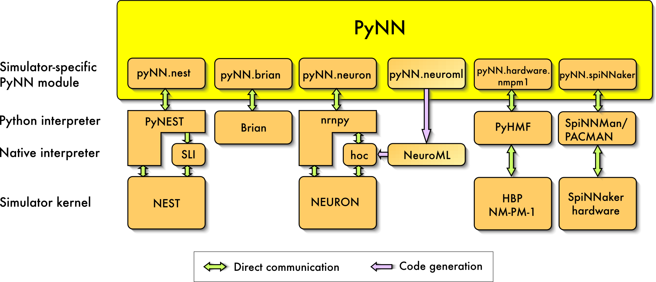
A unified interface for neuronal network simulators
Simulator-independent environments for developing neuroscience models:
keep the advantages of having multiple simulators or hardware devices
but remove the translation barrier.
Three (complementary) approaches:
GUI (e.g. neuroConstruct)
XML-based language (e.g. NeuroML, NineML)
interpreted language (e.g. Python)

Slide 8
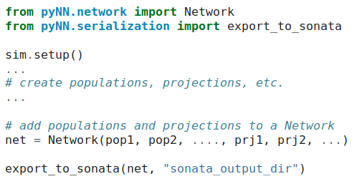
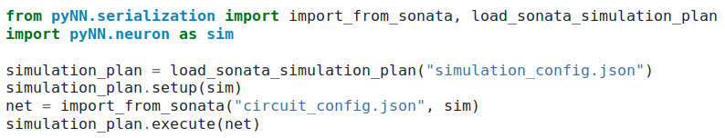
Sonata (pyNN support)
Large-scale simulation of biophysically-detailed neuronal circuits
→ sets specific constraints
Export to Sonata format
the SONATA Data Format emerges as the standard optimized for performance for simulation, analysis and visualization of large-scale circuits
(joint initiative of Blue Brain Project and the Allen Institute for Brain Science)
Import from Sonata format

Slide 9
SciUnit
https://github.com/scidash/sciunit
Include a validation framework in model development
Model
implements
Capability
requires
Test
What is SciUnit?
A Test-driven framework for formally validating scientific models against data. It employs the concept of Capabilities.
simulated observations
experimental observations
Score
What are Tests?
A procedure intended to establish the quality, performance, or reliability of a model
See Part II
What are Capabilities?
interfaces through which the model and the validation framework communicate
implemented as methods (functions) within the model
Requires the participation of modellers:
support to wrap your models for SciUnit
add/request new tests to the library
critique existing tests
suggest new features

Slide 10
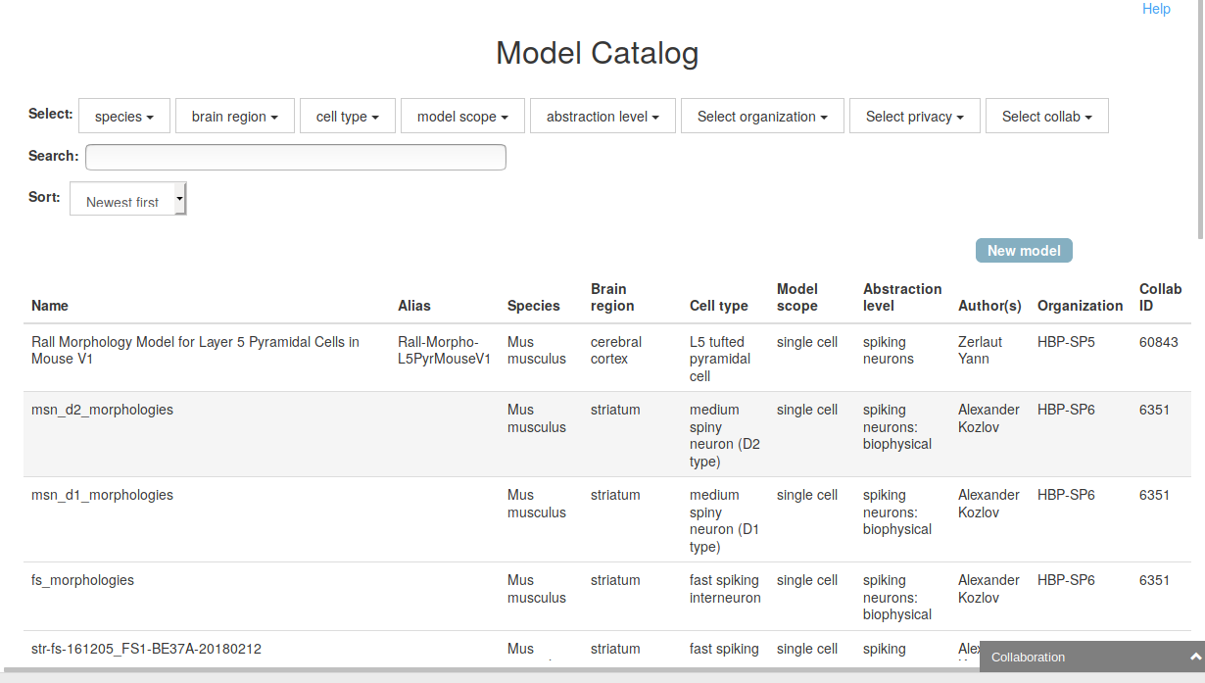
Model Catalog App
Hosts the models developed and/or used within the ecosystem of tools provided by the HBP Platforms
Enables 3 levels of “sharing”:
private: with user-defined collaborators
public: visible to all users
published: DOI + entry in the HBP Knowledge Graph
Two step process for publication:
1) Model submission by the users
2) Curation that the required “standards” are met

Slide 11
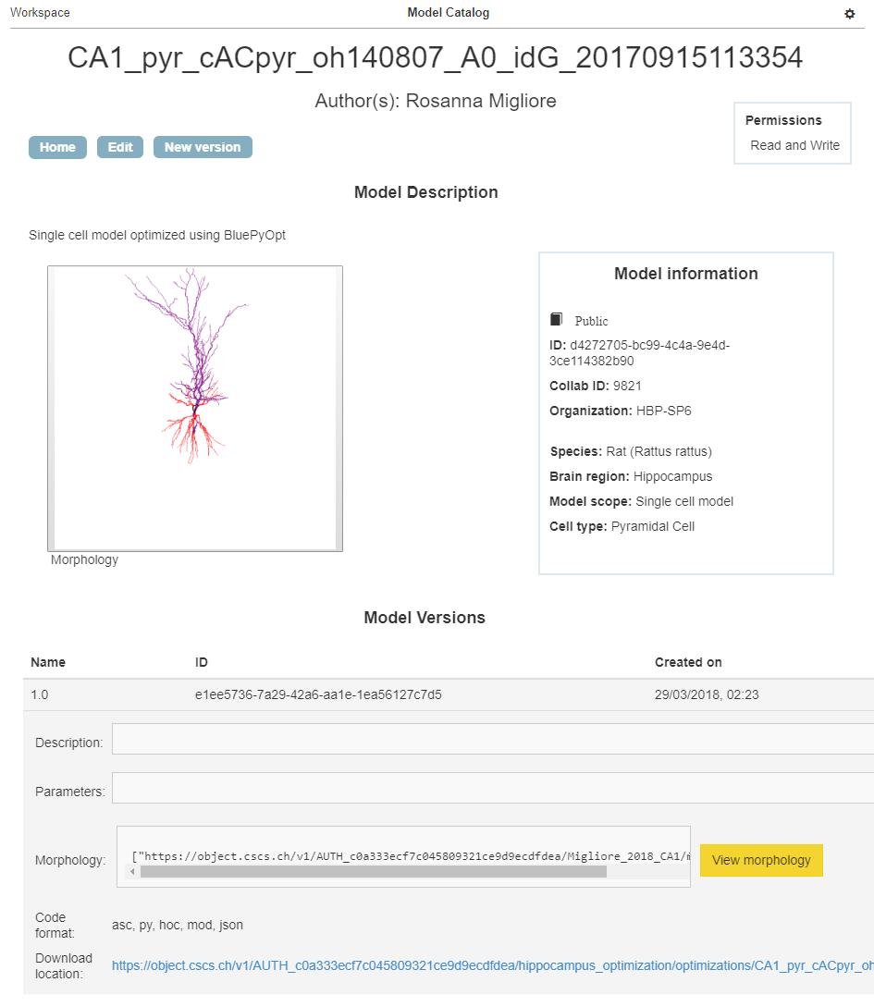
Model Catalog App

Slide 12
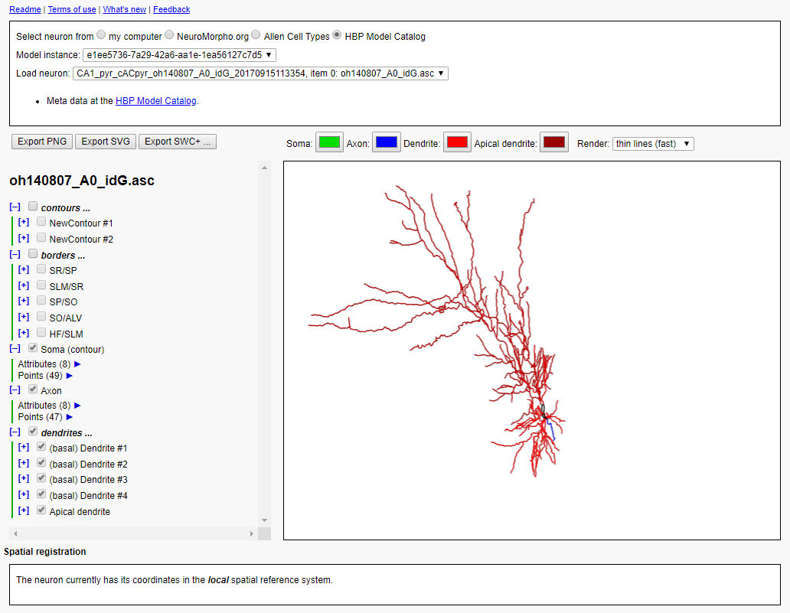
Model Catalog App – Morphology Viewer
Thanks to Rembrandt Bakker (Jülich) for his support on this task.

Slide 13
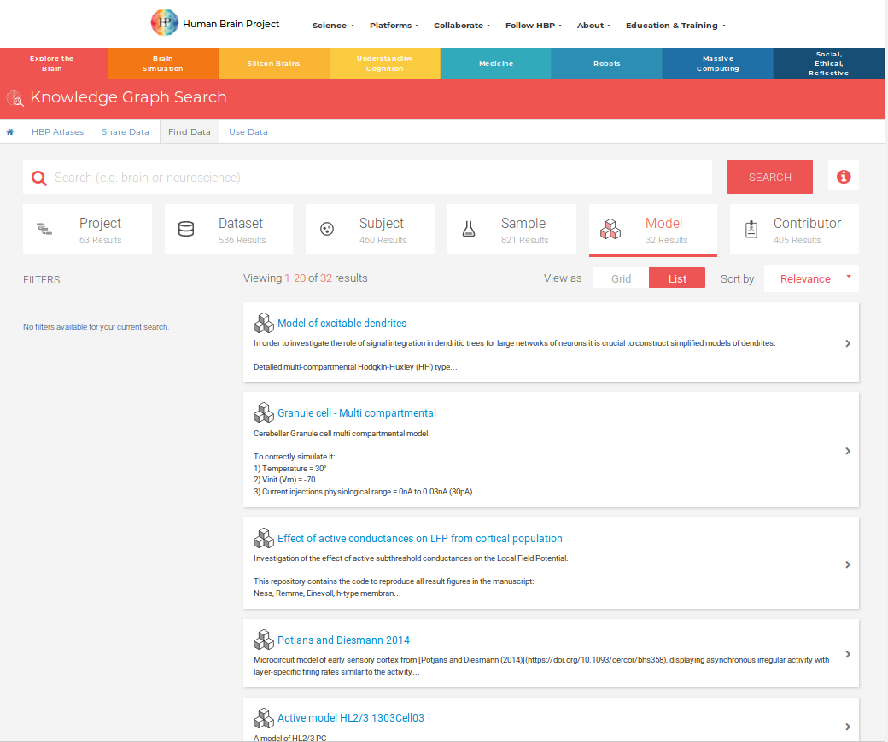
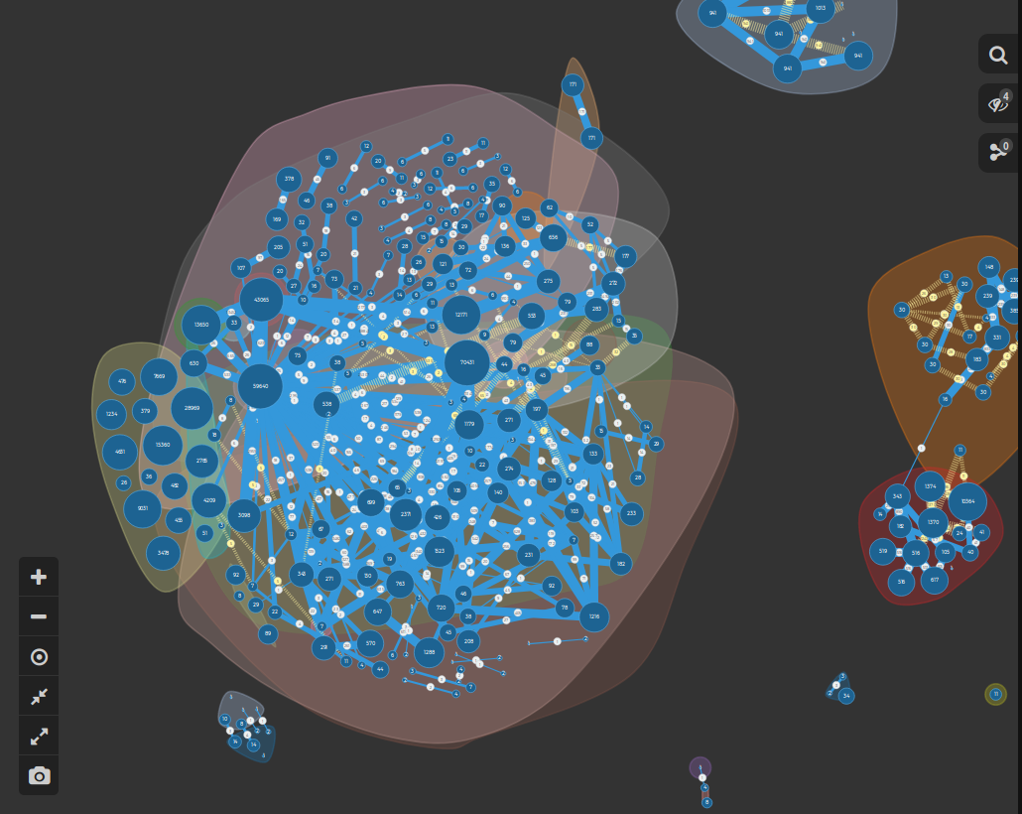
HBP Knowledge Graph
https://www.humanbrainproject.eu/en/explore-the-brain/search
Technical support that provides the required information to make research data:
Findable
Accessible
Interoperable
Reusable
(FAIR)
Linked data, Relational database

Slide 14
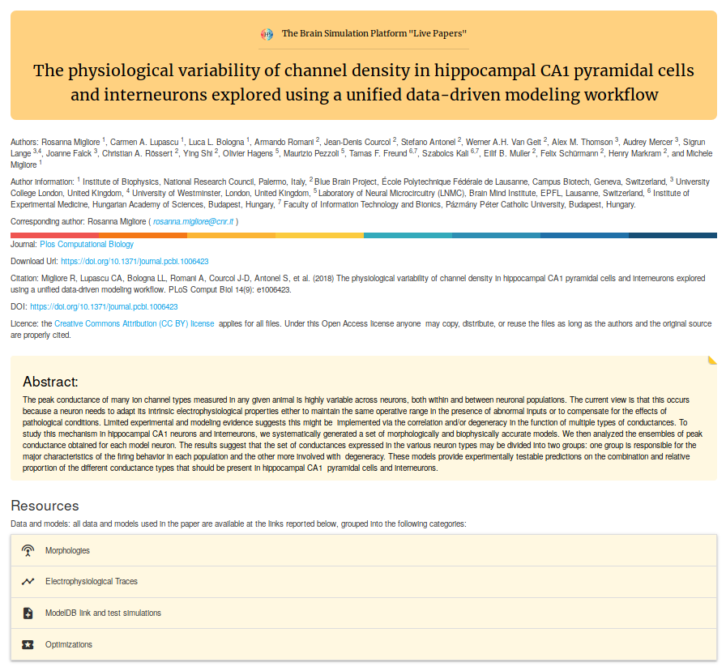
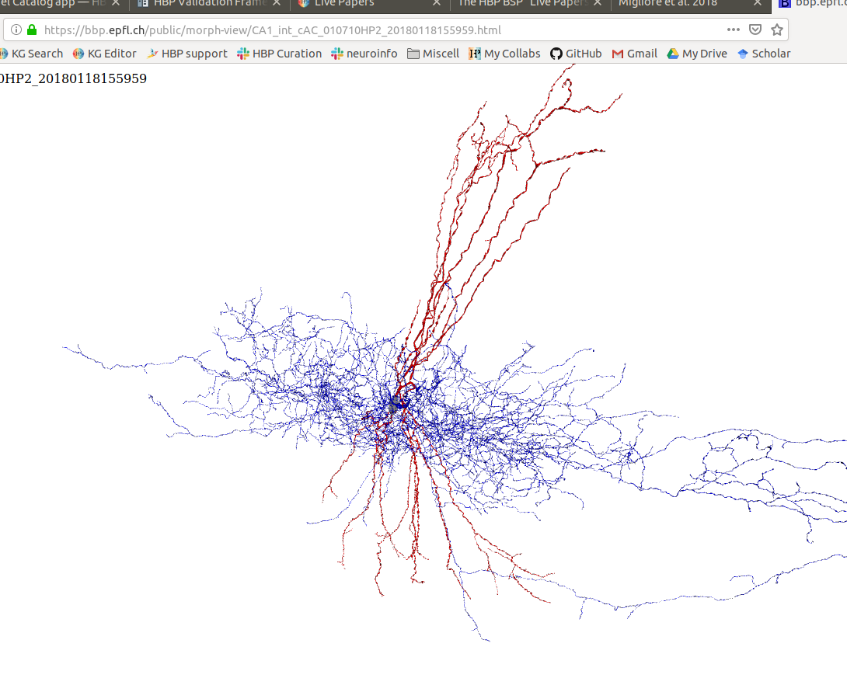
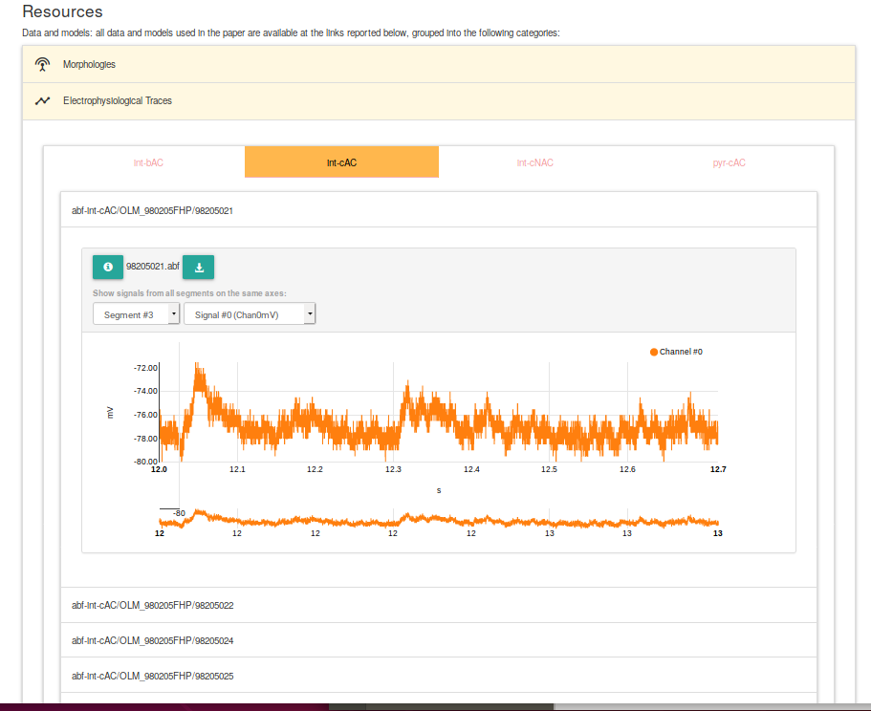
Live papers
https://www.humanbrainproject.eu/en/brain-simulation/live-papers/

Slide 15
Tools and applications

Slide 16
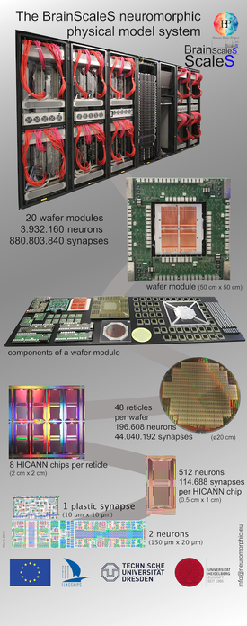
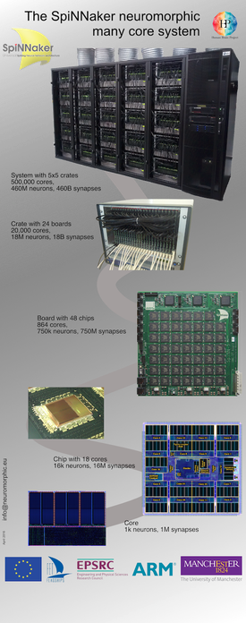
Neuromorphic hardware
Two complementary technologies:
Neuromorphic computing implements aspects of biological neural networks as analogue or digital copies on electronic circuits.
offers a tool to understand the dynamic processes of learning and development
applying brain inspiration to generic cognitive computing
Key advantages:
- energy efficiency
- execution speed
- robustness against local failures
- ability to learn
import pyNN.BrainScaleS as sim // import pyNN.SpiNNaker as sim
A common pyNN interface :

Slide 17
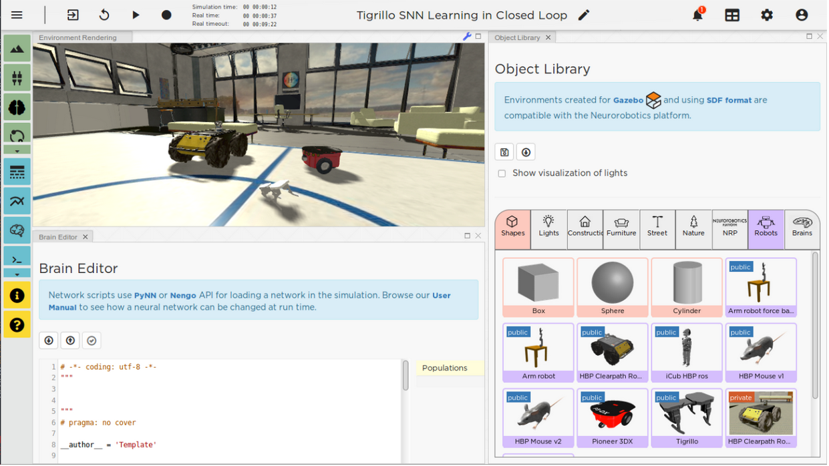
Neurorobotics
https://www.humanbrainproject.eu/en/robots/
allows researchers to give any simulated brain model its own “body” — virtual or even real — and explore how it controls movement, reacts to stimulus and learns in a virtual environment
The Platform is public, online, and available for all researchers who want to test their brain models or to build the brain-inspired robots of the future.

Slide 18
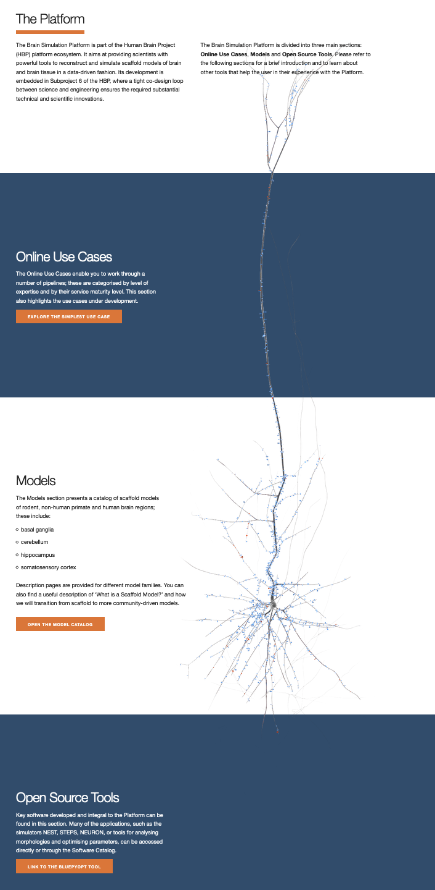
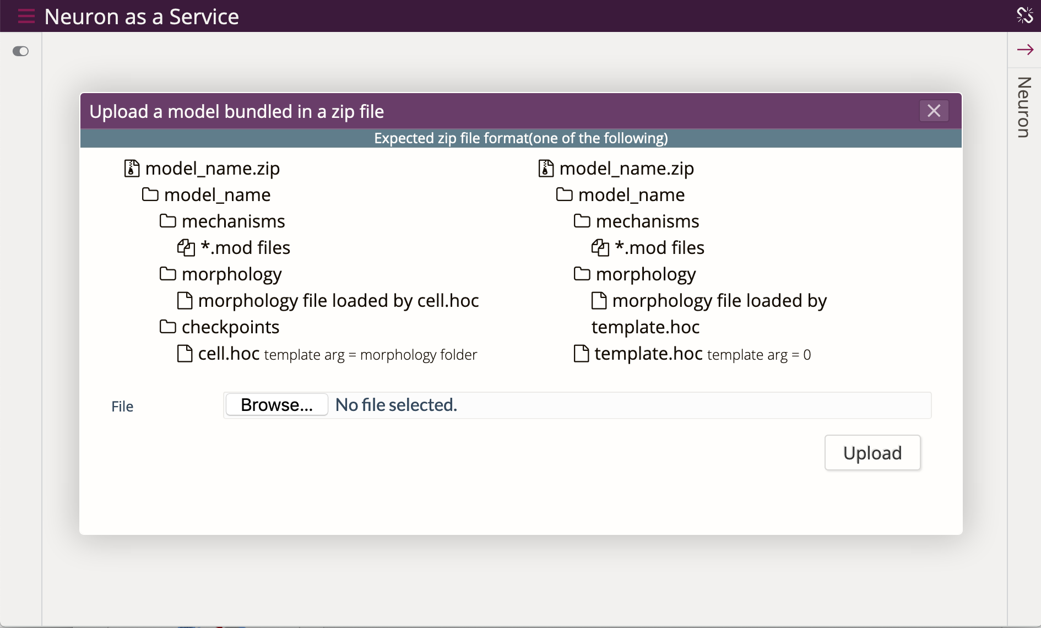
The Brain Simulation Platform
https://www.humanbrainproject.eu/en/brain-simulation/brain-simulation-platform/
The Brain Simulation Platform is an internet-accessible collaborative Platform designed for reconstruction and simulation of brain models.
Neuron as a Service (Blue NaaS)
https://blue-naas.humanbrainproject.eu/

Slide 19
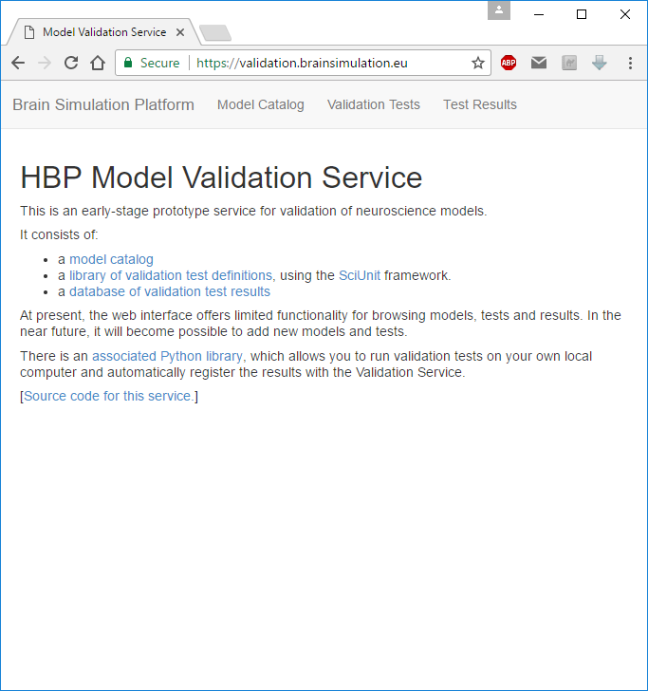
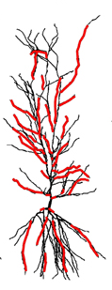
The Model Validation Framework
My_model_v2
Test (against data) | Score | Result
Resting Membrane Potential | 0.01 | Pass
Input Resistance | 0.20 | Pass
Action Potential Height | 0.05 | Pass
Oblique Integration | 4.73 | Fail
Spiking Frequency | 0.15 | Pass
Depolarization Block | 2.87 | Fail
● ● ●
Model Name | Net Score | Tests Passed
CodeJam et al., 2018 | 2.73 | 18
Xyz et al., 2010 | 3.25 | 15
My_model_v2 | 3.51 | 15
Random et al., 2014 | 4.73 | 12
My_model_v1 | 5.02 | 10
Abcde et al., 2017 | 5.09 | 10
● ● ●
Adds a new type of ionic channels with respect to: My_model_v1

Slide 20
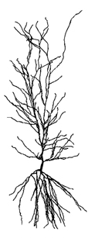

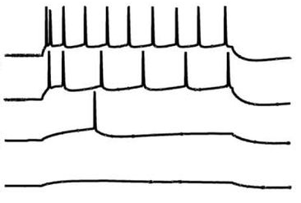


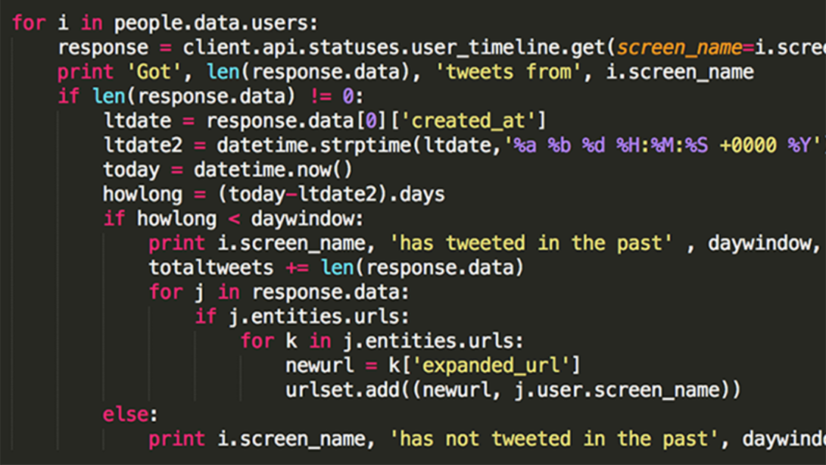
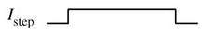
Validation Framework – Quick Overview
Model
Model
Developer
Validation Framework
Evaluate
Feature
#
I_{step}
Record
Library of Tests
Experimental Data
& Models
Capability
Spike count: I_{step} = 0.2 nA
I_{step} = 0.1 nA
I_{step} = 0.5 nA
I_{step} = 0.7 nA
Expected: # spikes = 1
# spikes = 0
# spikes = 6
# spikes = 9
Model Source Code
Images (adapted from): https://www.linkedin.com/pulse/source-codes-required-handover-govt-china-la-isms-dlip-ciseh-itil-

Slide 21



Validation Framework – Python Client
Model
Model
Developer
Validation Framework
I_{step}
Leveraging the functionality offered by two existing tools:
Record
Library of Tests
Experimental Data
Framework for test-driven validation of scientific model
MyModel
Test_SpikeCount
Implements Cap.:
Inject Current
Record Potential
Req. Capabilities:
Inject Current
Record Potential
For data-driven validation of neuron and ion channel models using SciUnit

Slide 22
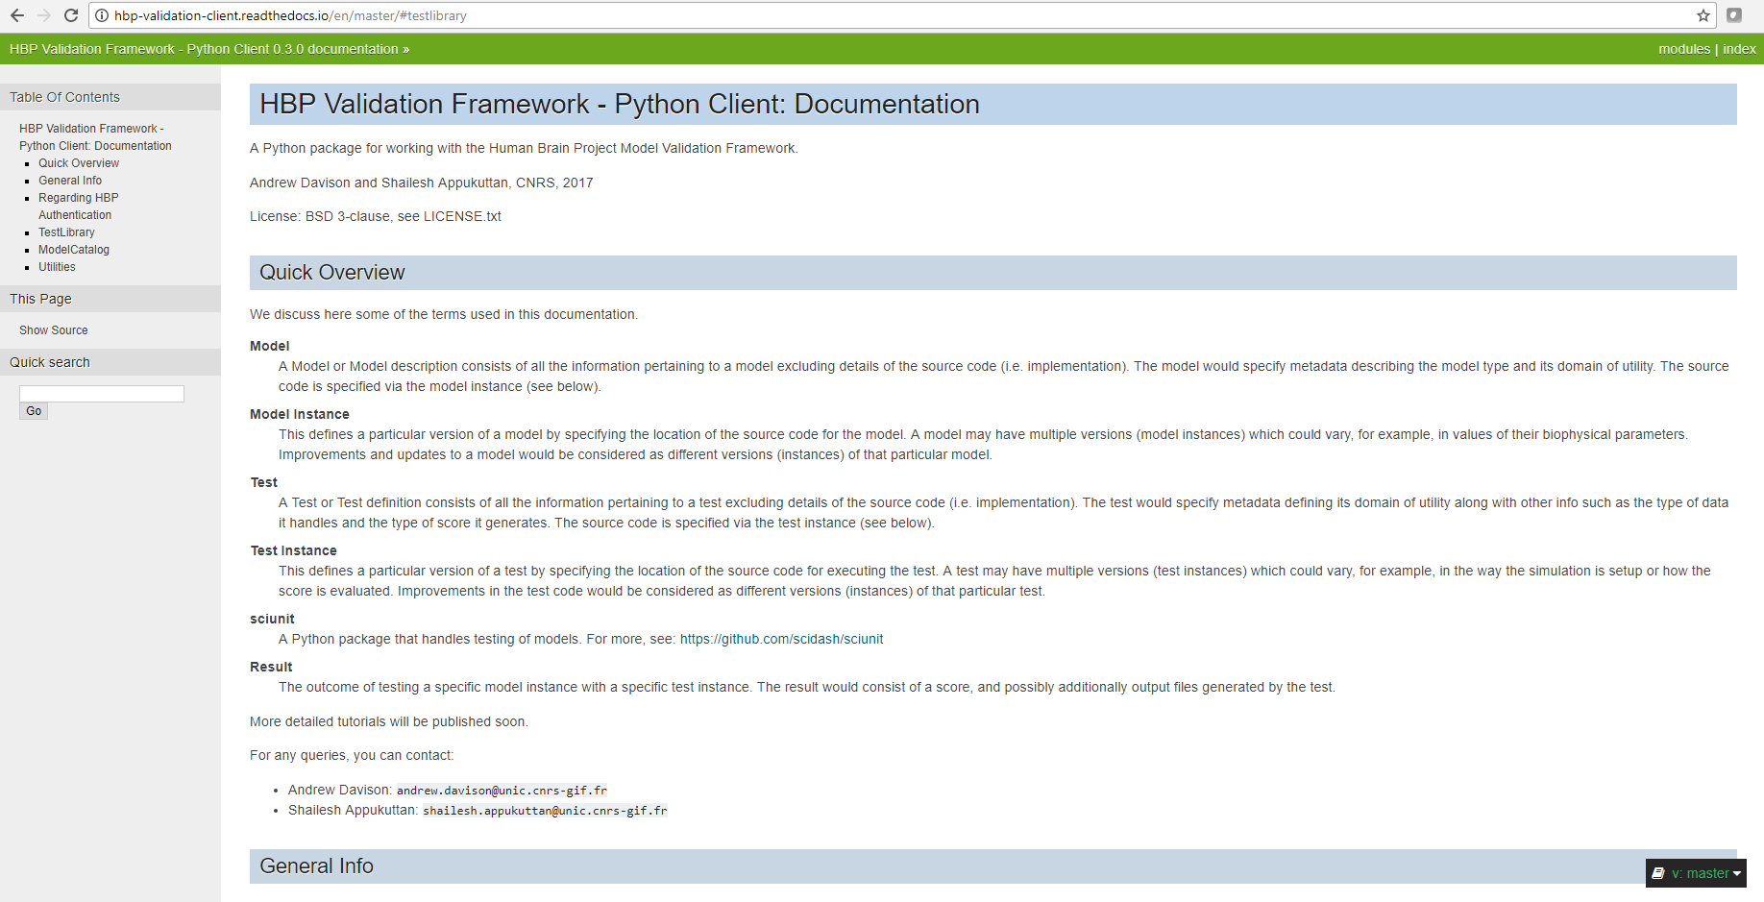
Python Client
http://www.hbp-validation-client.readthedocs.io
Tests | Models | Utilities
Get test definition Get test as Python (sciunit) class List test definitions Add new test definition Edit test definition Get test instances List test instances Add new test instance Edit test instance Get valid attribute values Get test result List test results Register test result | Get model description List model descriptions Register new model description Edit model description Get valid attribute values Get model instance List model instances Add new model instance Edit existing model instance Get figure from model description List figures from model description Add figure to model description Edit existing figure metadata | View JSON data in web browser Run test and register result Download PDF report of test results

Slide 23
Test Packages
The overall test suite has been divided into a number of components, some containing validation tests specific to particular brain regions, others more generic. All validation tests are written in Python, using the SciUnit framework. Some of these are listed below:
Test suites for specific brain regions
HippoUnit: https://github.com/KaliLab/hippounit
HippoNetworkUnit: https://github.com/pedroernesto/HippoNetworkUnit
CerebUnit: https://github.com/lungsi/cerebellum-unit
BasalUnit: https://github.com/appukuttan-shailesh/basalunit
Test suites for model features, independent of cell type or brain region
MorphoUnit: https://github.com/appukuttan-shailesh/morphounit
NetworkUnit: https://github.com/mvonpapen/simrest_validation
eFELUnit: https://github.com/appukuttan-shailesh/eFELunit

Slide 24
HippoUnit
Targeted at electrophysiological validations on detailed hippocampal CA1 pyramidal cell model. Simulation outcomes are tested closely against experimental findings. It currently comprises the following tests:
Somatic Features Test
Experimental data: Migliore et al. 2018
Depolarization Block Test
Experimental data: Bianchi et al. 2012
Backpropagating Action Potential (AP) Test
Experimental data: Golding et al. 2001
Post-Synaptic Potential (PSP) Attenuation Test
Experimental data: Magee & Cook 2000
Oblique Integration Test
Experimental data: Losonczy & Magee 2006
Developed by Sára Saray and Szabolcs Káli (IEM, HAS)

Slide 25
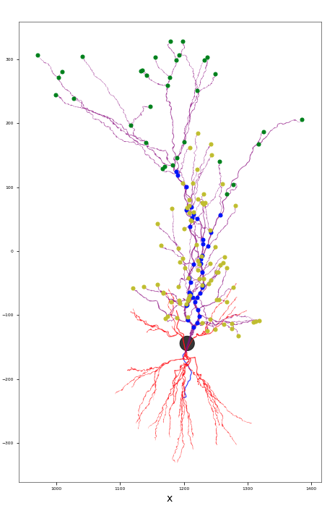
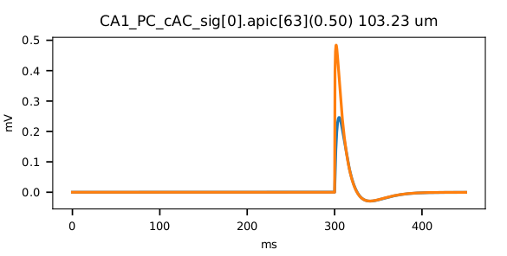
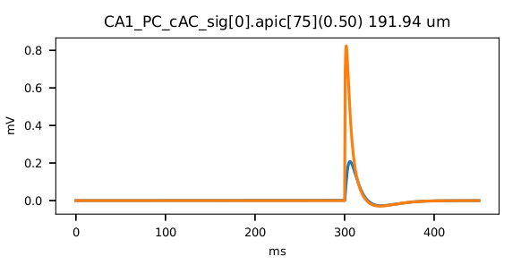
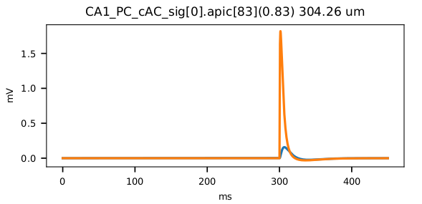
Post-Synaptic Potential (PSP) Attenuation Test
Neuronal Morphology
Model Responses
Apical Dendrites:
Trunk
Tuft
Oblique

Slide 26
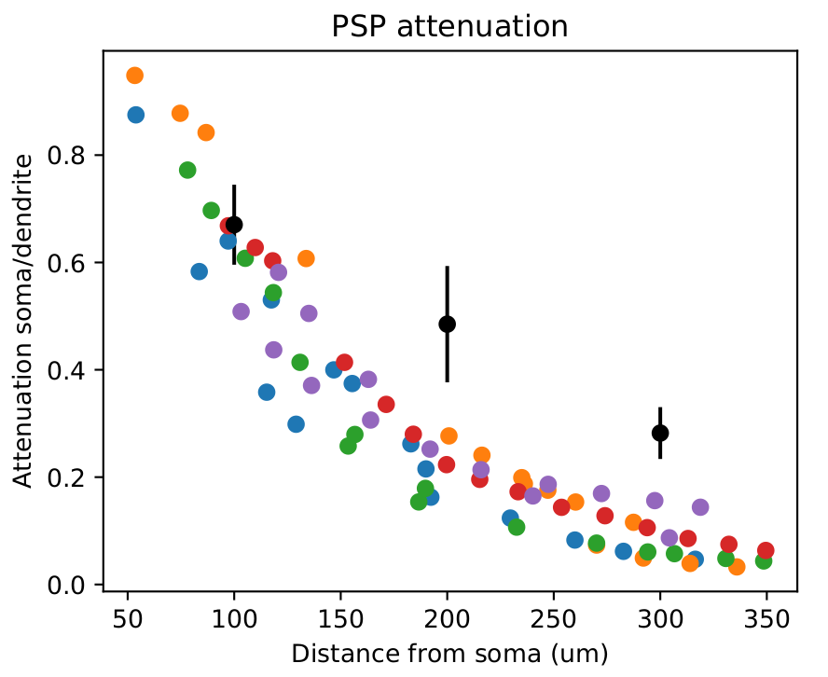
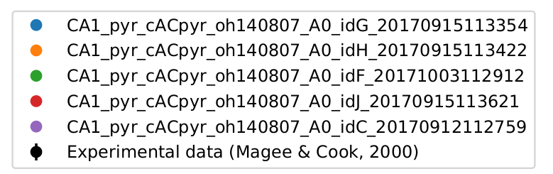
Post-Synaptic Potential (PSP) Attenuation Test

Slide 27
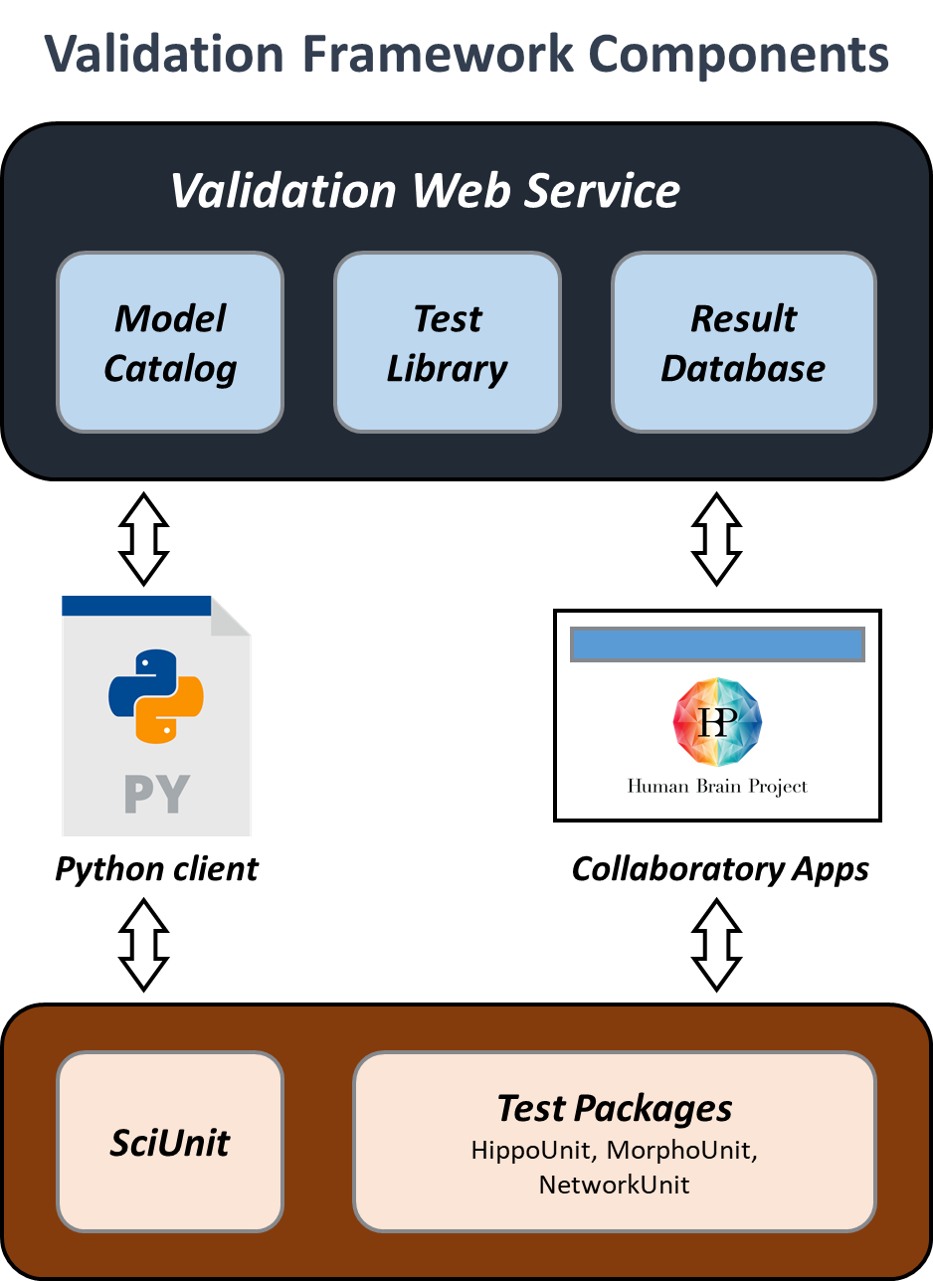
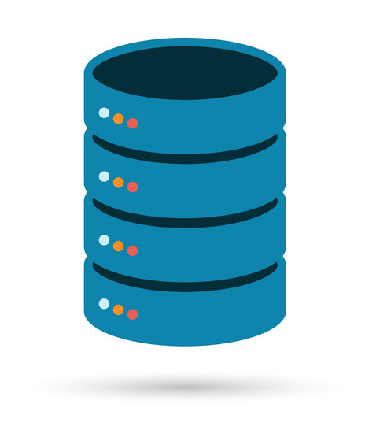

Validation Framework – Various Components
HPC Resources
(e.g. Jureca)
Data Store
(e.g. CSCS Pollux Storage)

Slide 28
Summary

Slide 29
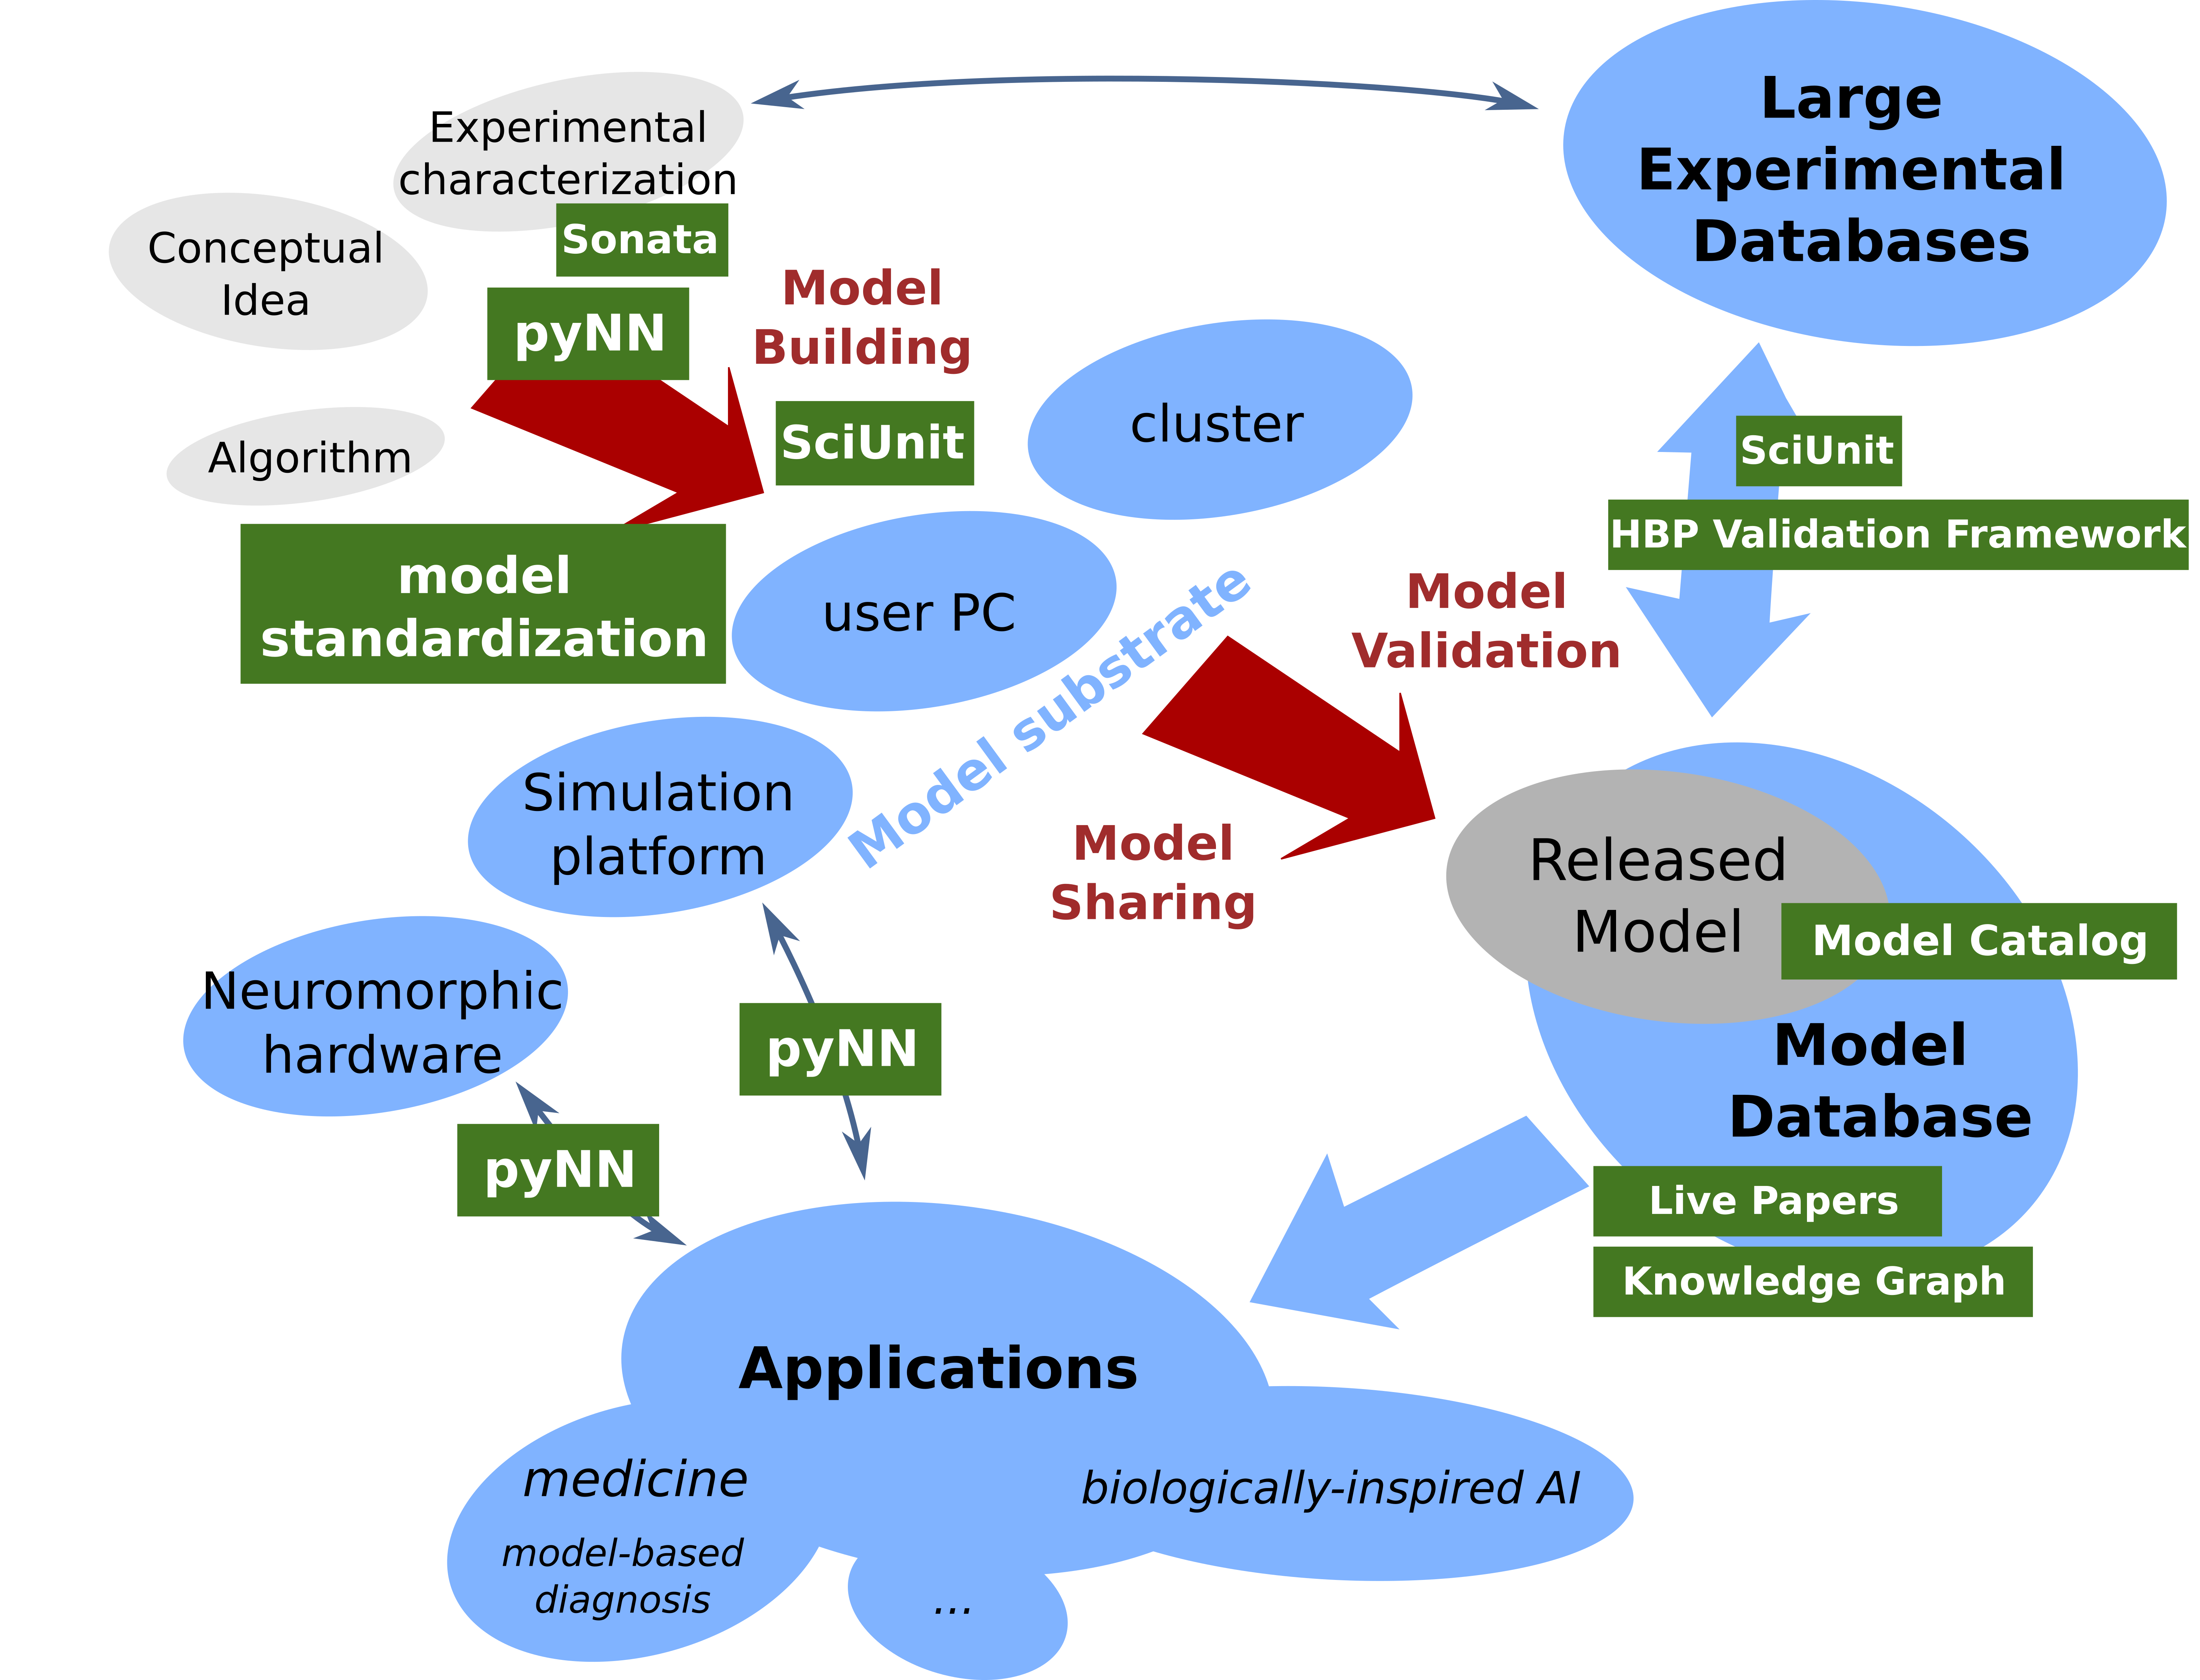
Summary

Slide 30
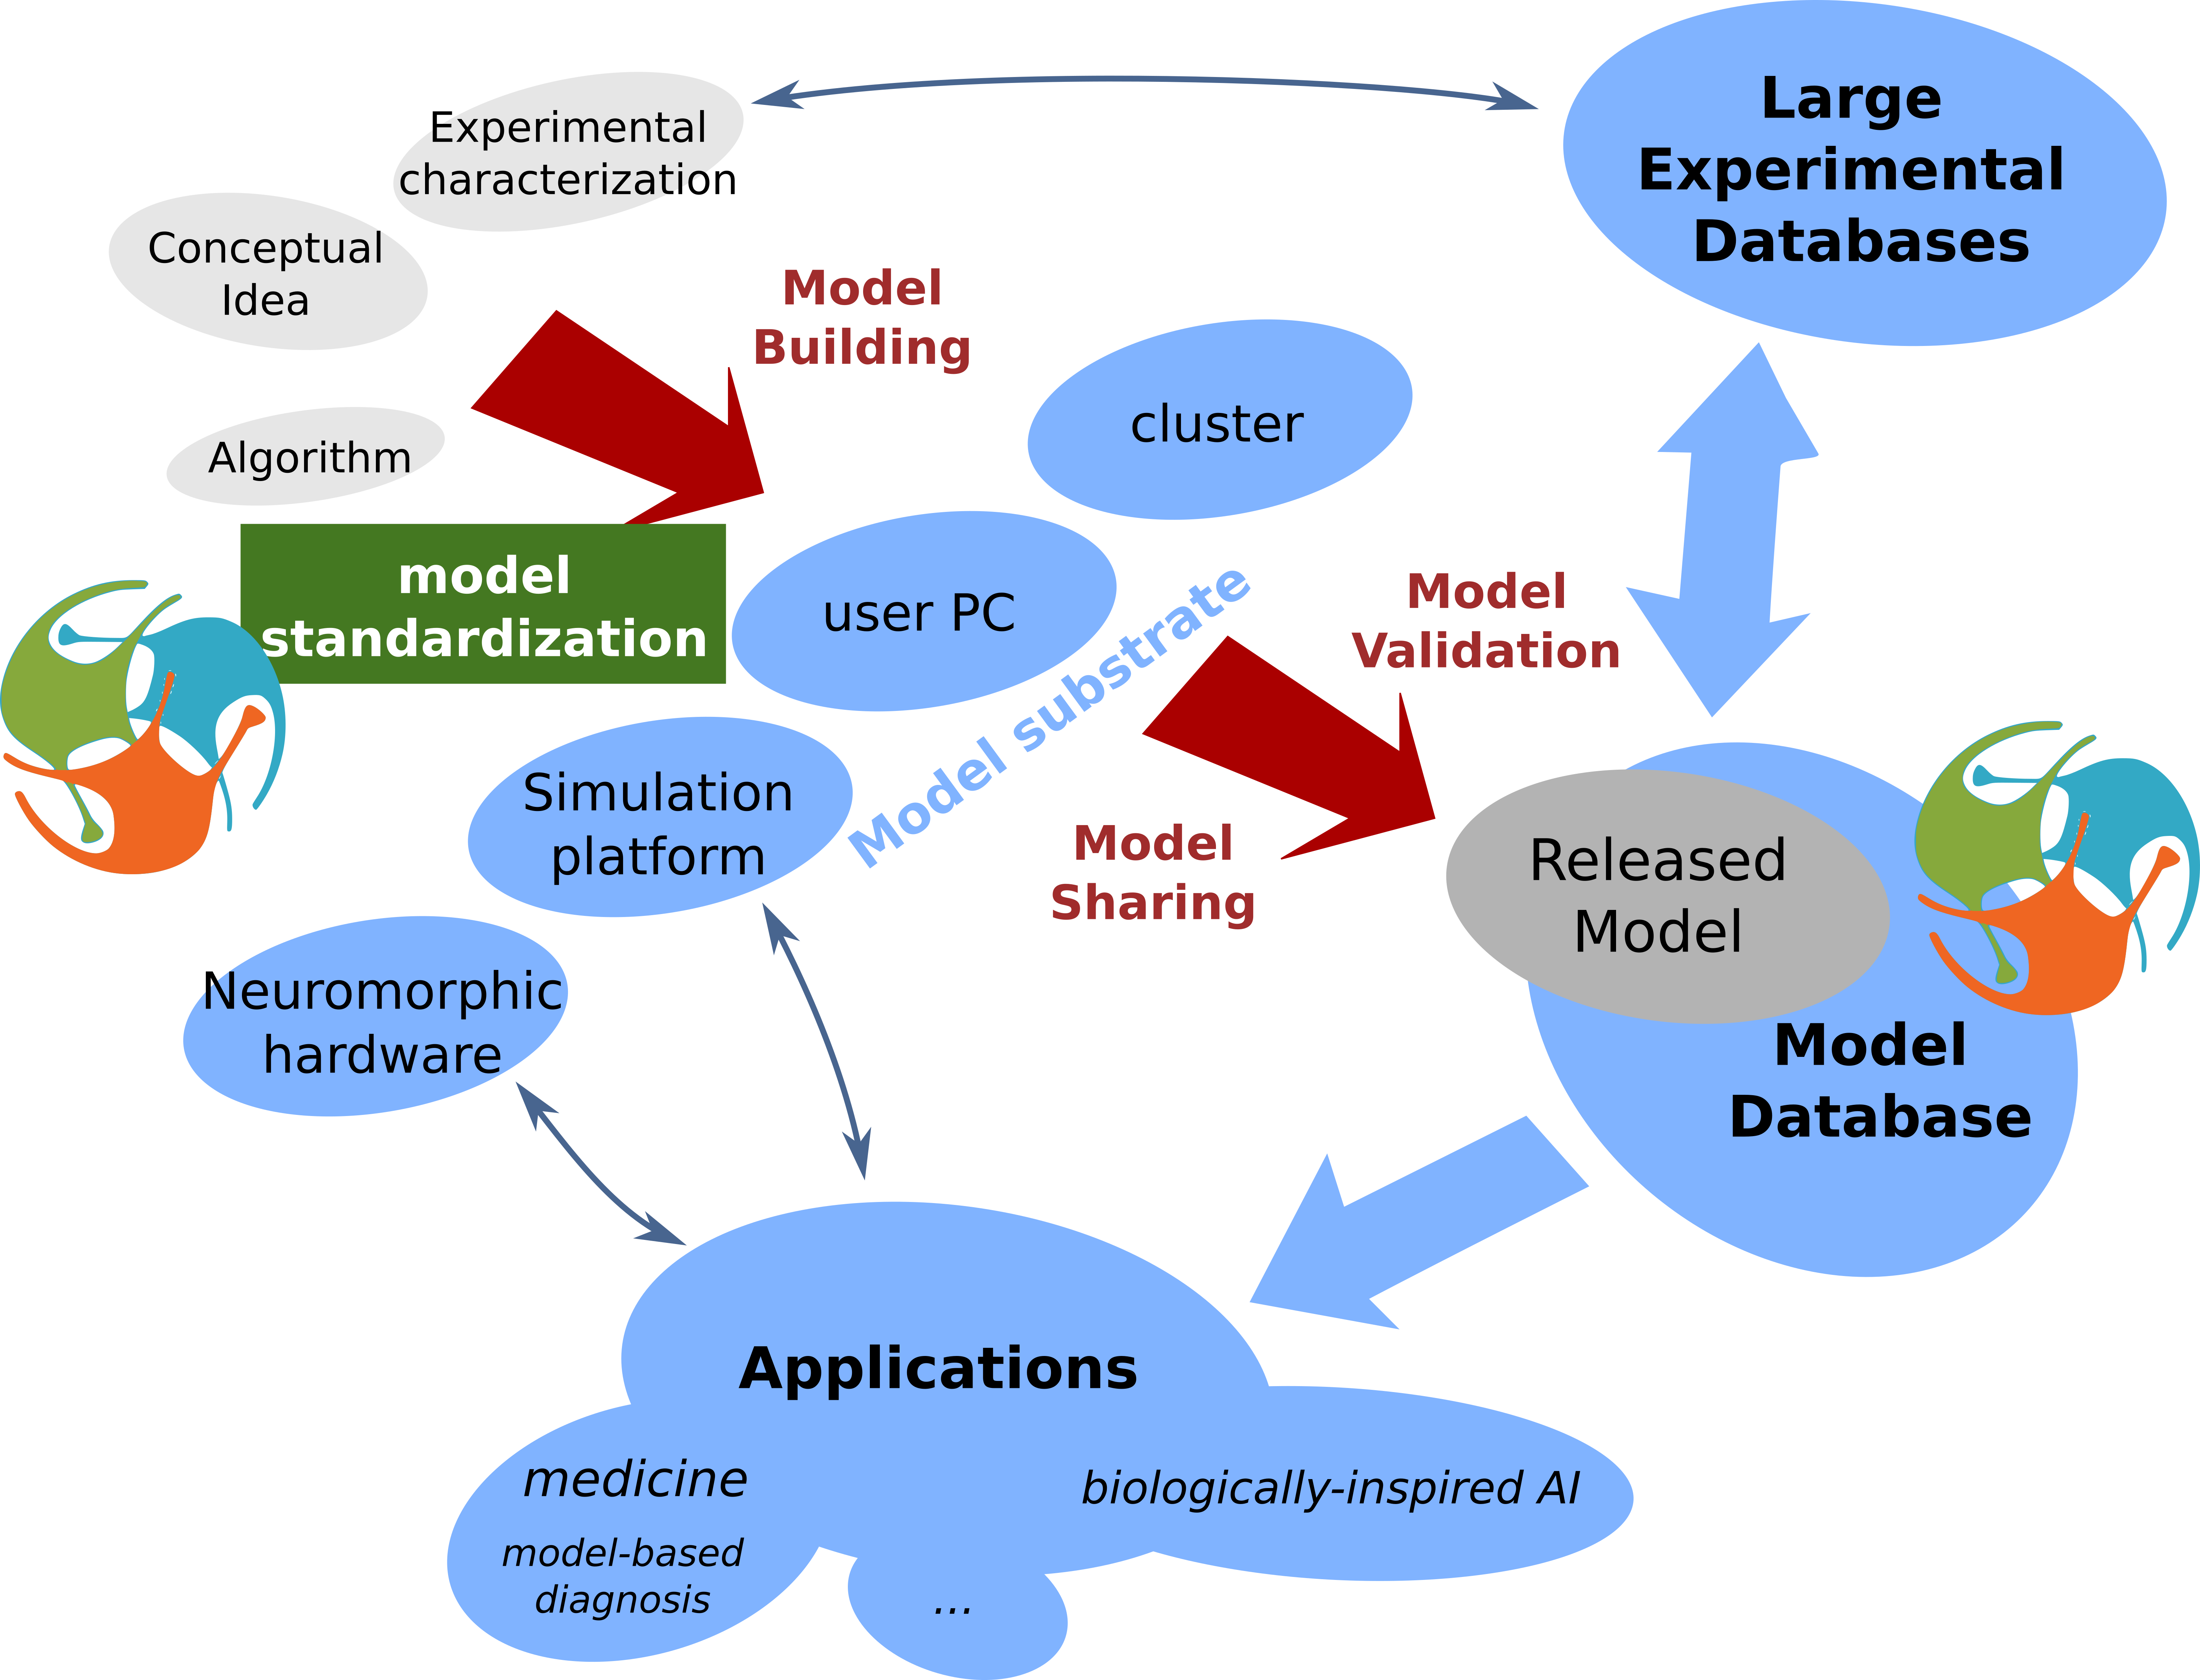
Summary

Slide 31
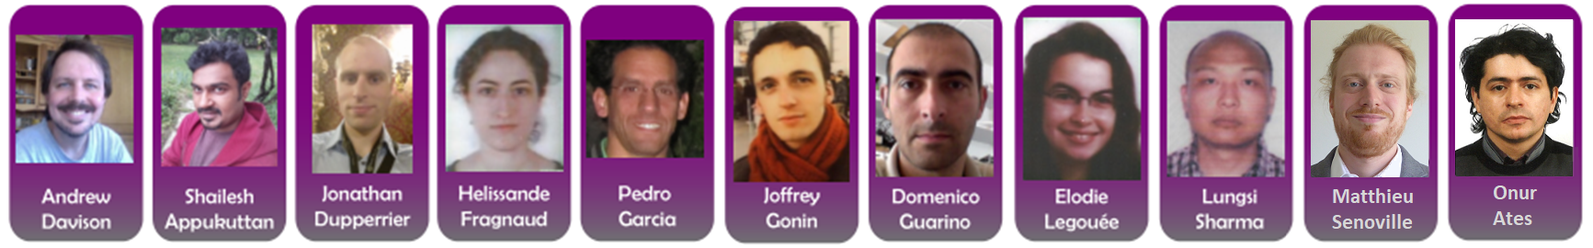
Thank you

